Slide 1

FAQ | Closed Beta | Feedback
login
Meet New People. Explore New Worlds.
Only Possible in ✨VR ✨
Get in line

Slide 2

Be Truly You
Choose from all kinds of profile tags – this lets ROVR match you with awesome people and events.
Sword Art Online
Game Dev
Backpacking
Beatsaber
+ thousands more

Slide 3


Be Truly You
Choose from all kinds of profile tags – this lets ROVR match you with awesome people and events.
LGBTQIA+
Avatar/World Design
Nature
Portal
+ thousands more

Slide 4

Be Truly You
Choose from all kinds of profile tags – this lets ROVR match you with awesome people and events.
Student
Rick and Morty
Streaming
MOBA
+ thousands more

Slide 5






Meet Cool Randoms
Your Guest List is full of people who share your interests and quirks. Wave at each other, say hi, then meet up in VR!

Slide 6




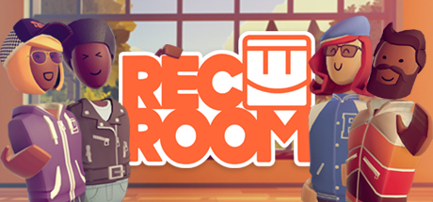

Hang out
Anywhere in VR
Bypass annoying public lobbies. ROVR helps you grow your squad, friendgroup, or community across all VR headsets and games.
+ 1000’s more games and worlds

Slide 7
Ready to get social?
GET IN LINE

